Slide 1
« Programme D’Analyse Des Systèmes Educatifs de la CONFEMEN » (PASEC) INITIAL TECHNICAL MEETING OECD Paris (France) - Du 27 au 28 juin 2013

Slide 2
1. Introduction to CONFEMEN and to PASEC 2. pasec reform and international evaluations after 2013 3. Time table for international evaluations 4. Challenges for pisa in sub saharan african region

Slide 3
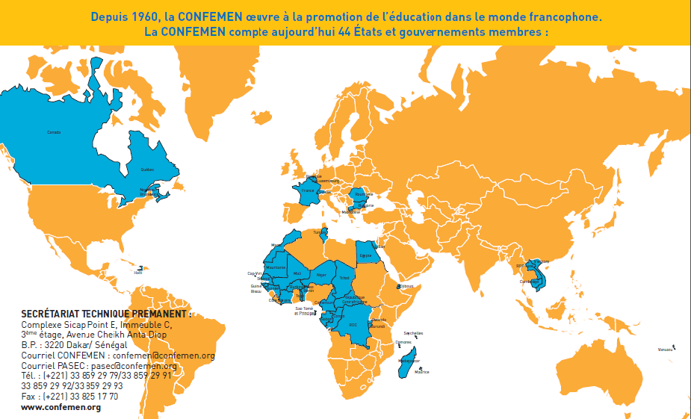
1. Introduction to CONFEMEN and PASEC
CONFEMEN: Conférence des Ministres de l’Education des Etats et Gouvernements membres de la francophonie (44 countries)

Slide 4
CONFEMEN missions :
Inform its members on the evolution of education systems and ongoing reforms,
Feed in the reflection about common topics of interest, promote Education for All, diversify resources and improve efficiency.
Facilitate concertation between the Ministers et experts in the purpose of supporting education sector policies, and the management of education systems.

Slide 5
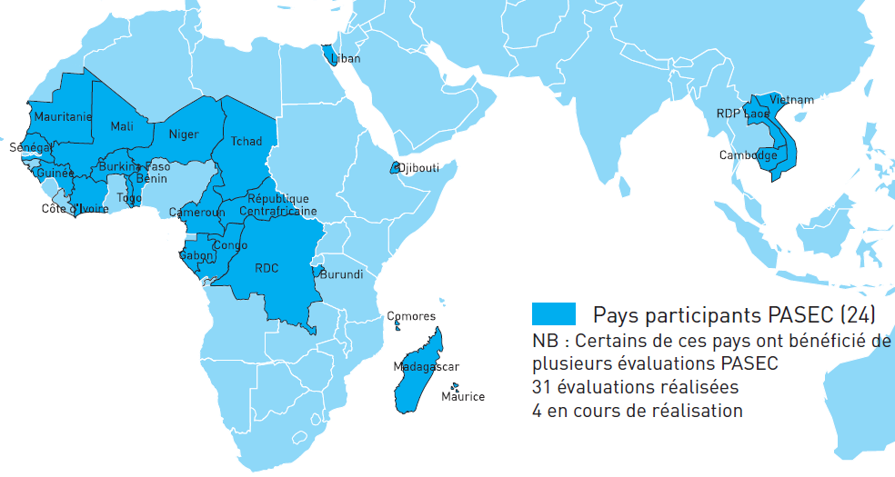
Le PASEC :
The Programme d’Analyse des Systèmes Educatifs de la CONFEMEN (Education Systems Analysis Program) has been created in 1991. For the past 20 years the PASEC has been running National and Thematic Evaluations under countries’ requests. Since 2012, the PASEC has set up a new framework for international comparative evaluations in 10 African countries.

Slide 6
PASEC Objectives:
Identify Basic Education effectiveness and equity factors applying to education systems, schools, teachers and students
Provide indicators to national sector policies for monitoring and mutual comparison, in the francophone area and beyond (via the partnership with SACMEQ).
Contribute to the development, at country level, of national education system capacity and foster the research through a knowledge community.
Disseminate evaluation results at international level.

Slide 7
How PASEC operates :
A Steering Committee for defining PASEC strategic orientation and monitoring PASEC action plan;
A Scientific Committee as a warrant of the scientific quality of the PASEC results accordingly to International standards;
At country level, National PASEC teams, composed of national experts in charge of implementation;
At central level (in Dakar CONFEMEN H.Q), a team of Technical Advisors, provide guidance quality control training coordination and communication.
Ressources are provided by
CONFEMEN countries’ contributions
Financial Partners (AFD, WB)
35% of the country evaluation cost is supported by the countries themselves
The selection of countries is made by the CONFEMEN under a process of application from candidate countries;

Slide 8
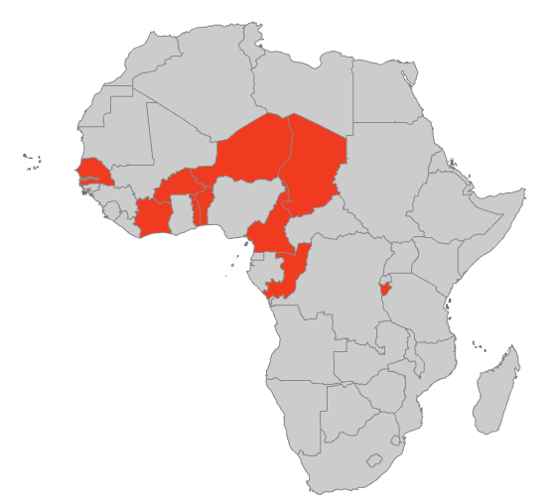
2. New orientations and méthodology for PASEC international evaluations :
10 countries evaluated in 2014 : Benin, Burkina Faso, Burundi, Cameroun, Ivory Coast, Congo, Niger, Senegal, Chad, Togo.
A regular evaluation cycle, every four years ;
Occurring at 3 key moments of the school life :
– Entrance into the schooling (2nd grade of primary);
– End of primary cycle (6th grade of primary);
– End of Basic Education cycle (end of lower secondary school)

Slide 9
Representative samples at national level (180 schools/20 students per class)
A partnership with the SACMEQ enabling score comparison at the Continental African level, and sharing experiences on practices and sector policies between Anglophone and Francophone African countries.
Student performance comparison at the end of primary school, at a given moment between all particpating countries ( 10 PASEC countries and 15 SACMEQ countries)
and a time log comparison for a given country of its own performance

Slide 10
Standardised test administration and data analysis procedures according to International evaluation standards (type of PISA, PIRLS or SACMEQ) for better international comparisons.
A multi-level analysis methodology for spotting efficiency factors and taking into account the part of scores variance related to students, schools and sector policy characteristics.
A test psychometric analysis methodology (Item response Theory IRT) considering the item’s difficulty level and student’s skills at 6th grade. This allows positioning students on a similar proficiency scale.

Slide 11
New PASEC Evaluation Tools:
2nd and 6th grade tests:
They are built upon :
Expected basic skills from students in 6th grade of primary school, essential for schooling continuation and recognized by the international community of researchers in pedagogy and education psychology,
Official curricula implemented in the countries.

Slide 12
Tests objectives at 6th grade are to :
Identify the proficiency level in writing comprehension and in the domain of mathematics (numeracy, measures, geometry) expected skills : decoding, extract information, deduce, analysing and giving opinion / to know, to implement, to reason in mathematics).
Spot education systems efficiency factors in primary school.
Enable students assets’ international comparison between all PASEC countries on one hand , but also with SACMEQ countries.
(2 hours test in maths and writing comprehension, 4 booklets -60 items- in the two disciplins with a block of common items)

Slide 13
Tests objectives at 2nd grade:
Detect students gaps , at the very beginning of the schooling, in order to adapt and re-orient teaching, curricula, pedagogy and practices, and more globally sector policy (at 2nd grade the comparison is possible only for countries sharing the same teaching language ).
Assess directly the students level upon unique competences and not upon a set of competences (one item = one competence assessed) in oral comprehension, reading, writing comprehension, numeracy
Individual test administration, orally to detect the real level in very targeted skills.

Slide 14
Questionnaires :
Questionnaires to students, teachers, schools directors and to the ministries (administration) :
Student socio economic level
Student familial context
Appetite for reading and maths
Self esteem
Student ‘s schooling history
School environment (well being at school)
Classroom, school and community infrastructures
Pedagogical resources available at school level
Pedagogical practices / teachers’ training
School management
School time management
–

Slide 15
3. International PASEC evaluations time table
2012
Call for application, selection of countries
2013
Instruments adaptation and traduction
2014
Test administration in 10 countries
Entering data and processing
Création of new instruments ( test and questionnaires)
Group meetings (2)
2015
Test psychometric analysis
2016
International report
Sampling
Data econometric analysis
Testing of tools in 10 countries
Thematic analysis reflection around national reports
International training (1) and Group meeting(1)
Group meeting(1)
Partnership with SACMEQ
International publication, and dissemination of results (international event)

Slide 16
Other activities:
Construction for PASEC of common skills scales at the end of primary school and at the end of lower secondary school (available in 2015).

Slide 17
4. Context and challenges for a pisa evaluation in africa region
Net intake rate at the entry of lower secondary : between 20% and 45% for PASEC African francophone countries
Weak competences at the exit of the primary school with repercussions on the lower secondary:

Slide 18
Issues at stake:
Adapt questionnaires to field reality
Adapt data collection procedure to field reality and resources constraints.
What proximity operational support could be given to some countries having weak national evaluation systems and limited resources (human and equipment) ?
Taking into consideration students skills for those at the bottom of the PISA scale.
What methodology for sampling the population of out of school youth ?
What type of skills should be evaluated for out of school youth ( having been or not in primary school) ?

Slide 19
Merci de votre attention
www.confemen.org
pasec@confemen.org

